Slide 1

Software University
ADVANCED C#
Teamwork project – C# game
Team “Jeandan”

Slide 2
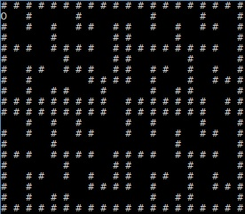
Project name – Labyrinth
Console based game
Type of game : maze/labyrinth
Includes secret questions
You must answer correct to continue

Slide 3
Team “Jeandan” members
Sava Ivanov
Antonio Todorov
Ivan Gergov
Georgi Yordanov

